Slide 1

CPSC 332 - PROJECT
Using MySQL To Connect Country Data At A Global Scale
Emiliano Manalo, Sean Lowry, Ava Saltzman, And Zeus Salinas

Slide 2

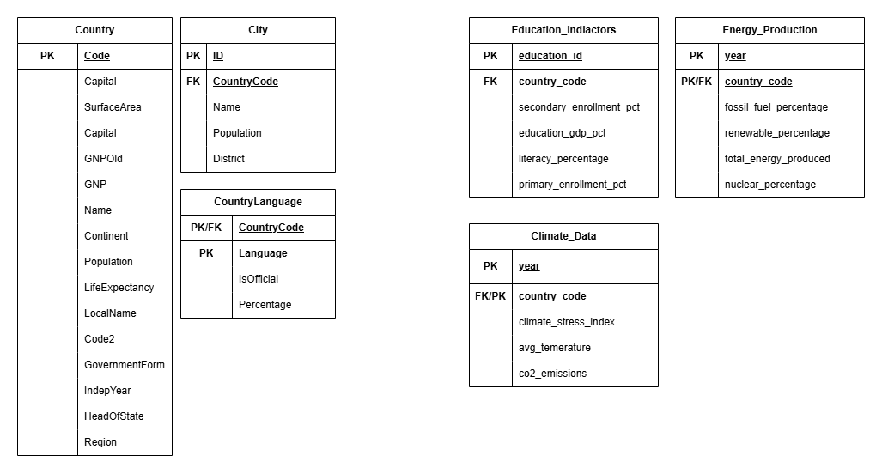
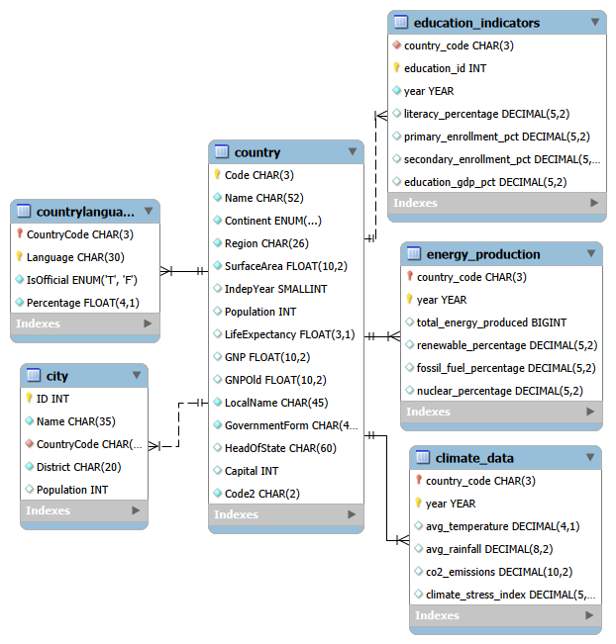
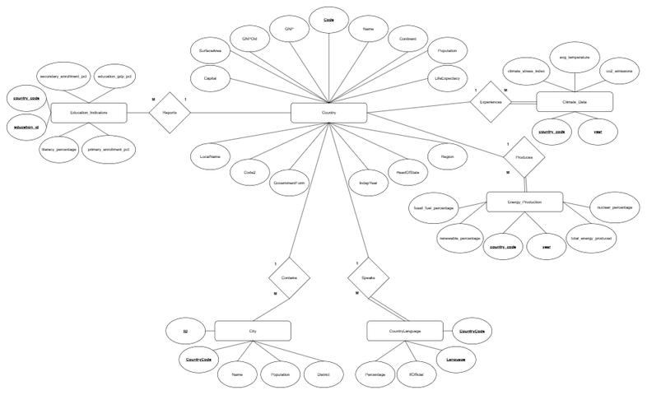
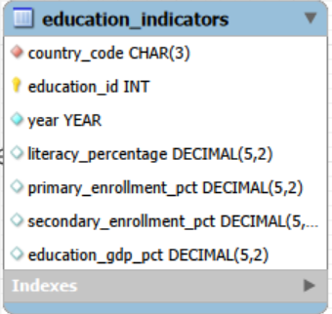
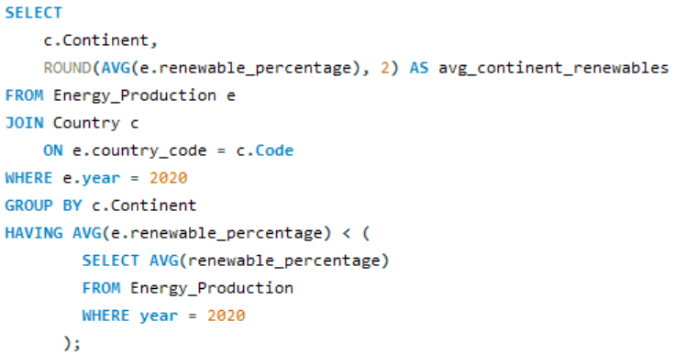
Table Of Contents
1.
2.
3.
Introduction
Database Schema
Physical Model
4.
5.
6.
ER Diagram
Tables
Queries

Slide 3
1: Introduction
Does Education Effect Climate Change? Industry? Energy Production?
How Can We Use A Database To See Possible Correlations; Organize Large Amounts Of Data?
In this project, we primarily focused on MySQL, database design, and database management. However, we also heavily focused on how data on education, climate, and the energy industry interact.
In this presentation, we will go over our database design, how we used it to answer our own questions, and key takeaways that we hope will provide some insights into both database design and the countries’ data we wanted to explore.

Slide 4
2: Database Schema
The tables on the right show the database schema we will use for this project. Each table has its own attributes along with the identifying PK (Primary Key) and FK (Foreign Key).
The Country, City, and CountryLanguage tables are all from the base schema provided. Education_Indicators, Energy_Production, and Climate_Data are newly added tables that describe the relationships among education, energy, and climate, year by year and country by country.

Slide 5
3: Physical Model
On the left, we have the physical model of our database. As you can see, the prior country, countryLanguage, and city from our base schema are now interconnected with our additional tables.
You can also see how primary keys and foreign keys relate to other in a more clear and concrete way.

Slide 6
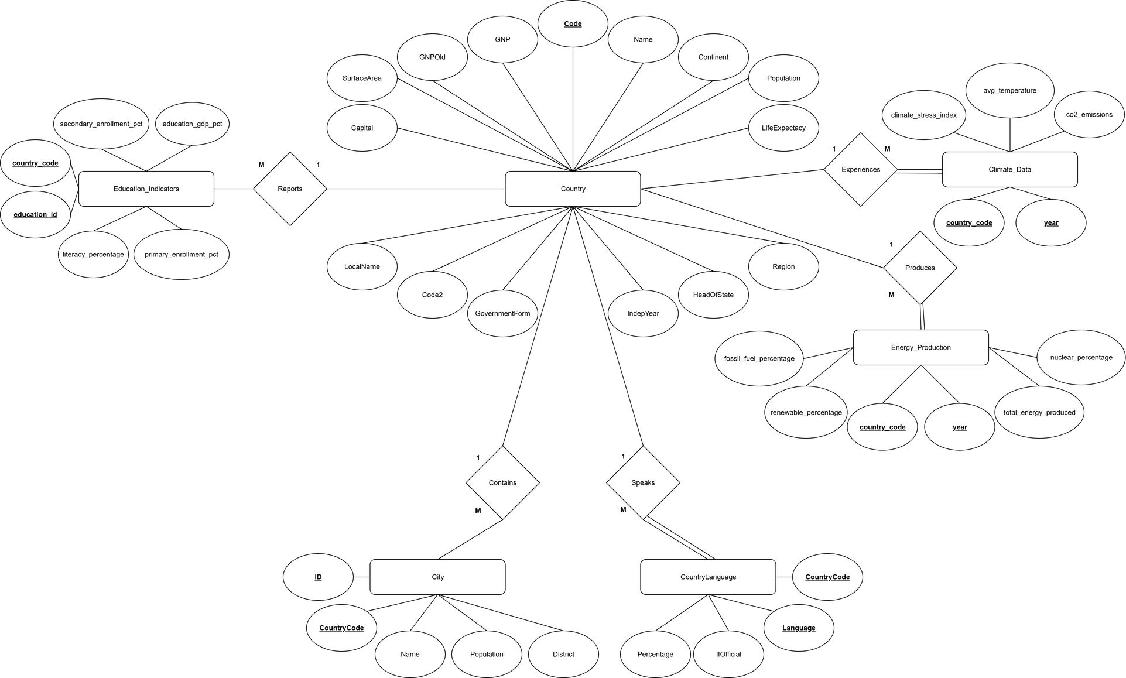
4: ER Diagram
Moving to the ER-Diagram, we can see how the cardinality and relationship between the entities.
Our primary entity is the country entity, which associates all our other sub-entities. We can also see how some entities are weak and need the parent entity to help determine specification.
In our design, we chose the new tables to be one-to-many, as we wanted scalability and further variety we wanted to analyze. Just not the current data for each entity.

Slide 7
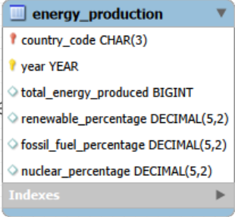
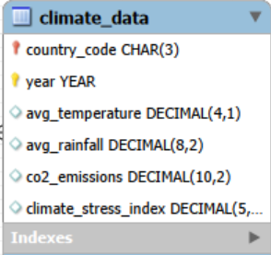
5: Tables
Education_Indicators
Energy_Production
Climate Data

Slide 8

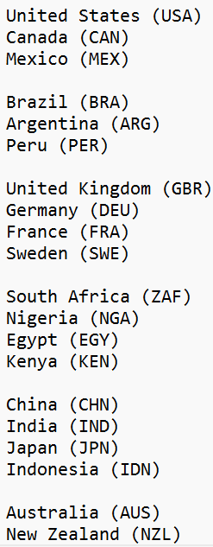

Data Sources And Chosen Countries
Data Sources
Chosen Countries
All data was used from the ourworldindata.org website. We chose this data source because it was the most relevant to our data research.
Though there were plans to integrate other data sources, we thought it was best to use a single data pipeline to maintain consistency across our analyses.
We chose countries that we were interested in. Along with a single year for most of these instances.
Though adding more yearly data may be ideal, for the example of demonstrating our queries, we kept the number of rows small. However, this can be expanded further with more data entries in the future.

Slide 9
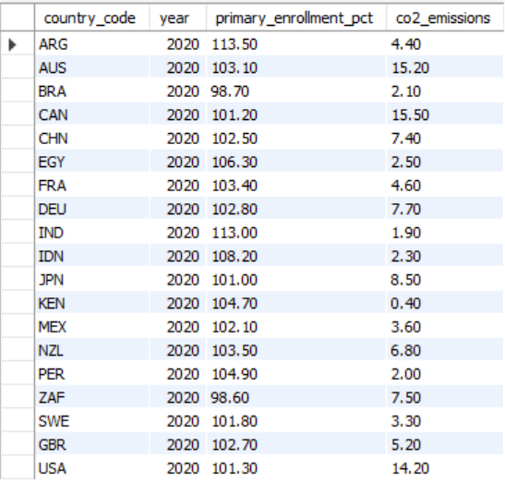
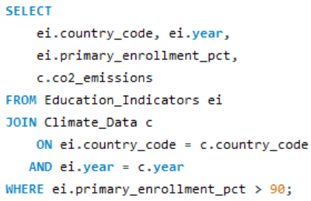
6: Query 1
Does High Percent Of Education Influence The Use Of Fossil Fuels?

Slide 10
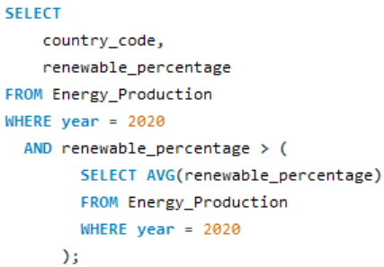
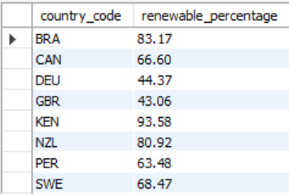
6: Query 2
Who Has The Highest Amount Of Renweable Energy Sources Globally

Slide 11
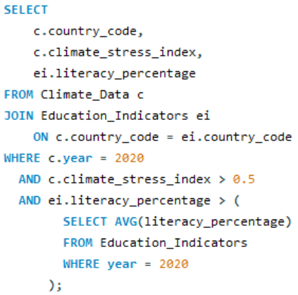
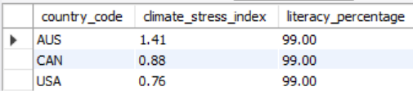
6: Query 3
Does High Literacy Effect Climate Stress?

Slide 12
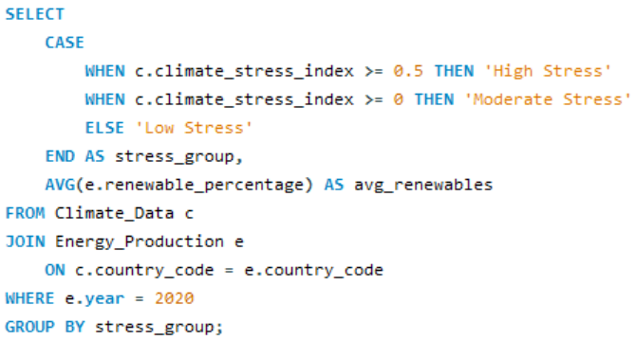
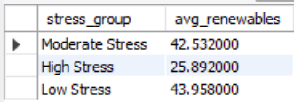
6: Query 4
What Climate Index “Stress Group’s” Avg Percent Of Renewable Energy

Slide 13
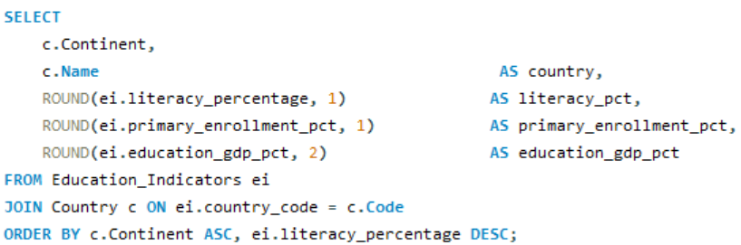
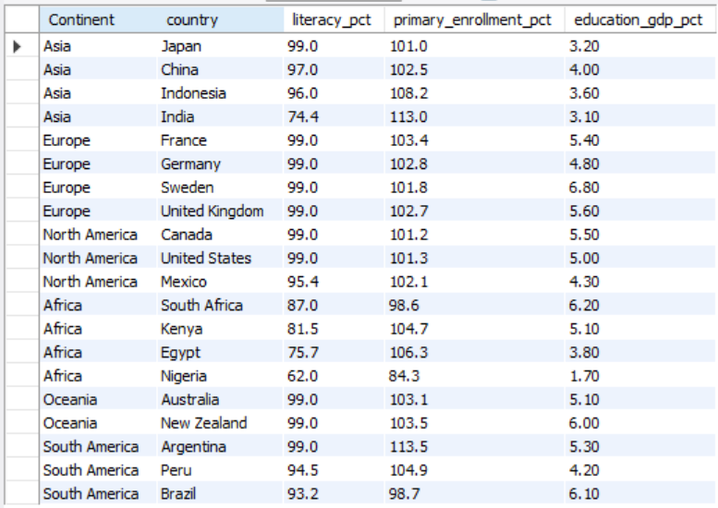
6: Query 5
Rank The Literacy Rates Of Each Country From Each Continent

Slide 14
Key Takeaways
Notable Takeaways:
How To Correctly Design A Database
The Importance Of Documentation
Practical Use Of A Database
The Need Of Databases To Analyze And Store Data
MySQL And Databases Are Important!
You never know when storing and querying data may be useful for you!

Slide 15
THANK YOU !

